Slide 1
ActionDirector Mobile Feature Proposal
PM: Elvis Chen

Slide 2
Feature & Schedule
2016
2017
11/3 v1.01
Rate us & Send feedback
11/17 v1.02
On screen helps (Tips)
11/24 v1.1
Title Designer: Border & Shadow
12/1 v1.2
Color Presets
12/15 v1.3
Rotate & Flip (TBD)
Add more color presets
1/B v2.0 (TBD)
Multiple clips support
Project

Slide 3
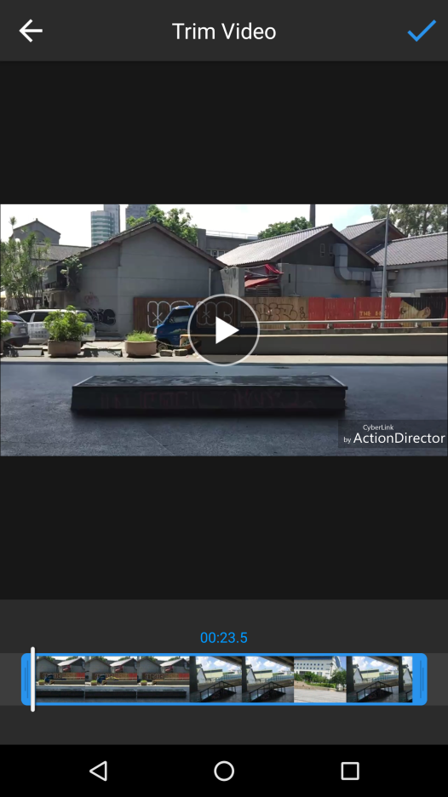
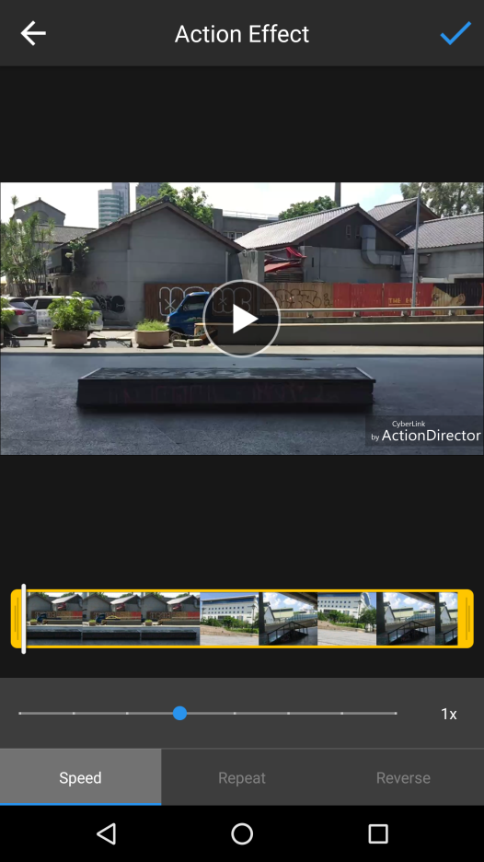
On Screen Helps
v
Show this tip next time
v
Show this tip next time
Video tutorial:
https://youtu.be/WcK4qwQrMrM
Video tutorial:
https://youtu.be/NcoBuo-sTBc
Play and Pause
Drag the white bar or tap timeline to seek the video
Drag the blue bars to set effect area
Drag the white bar or tap timeline to seek
Drag to adjust video speed
Drag the blue bars to mark
in and out

Slide 4
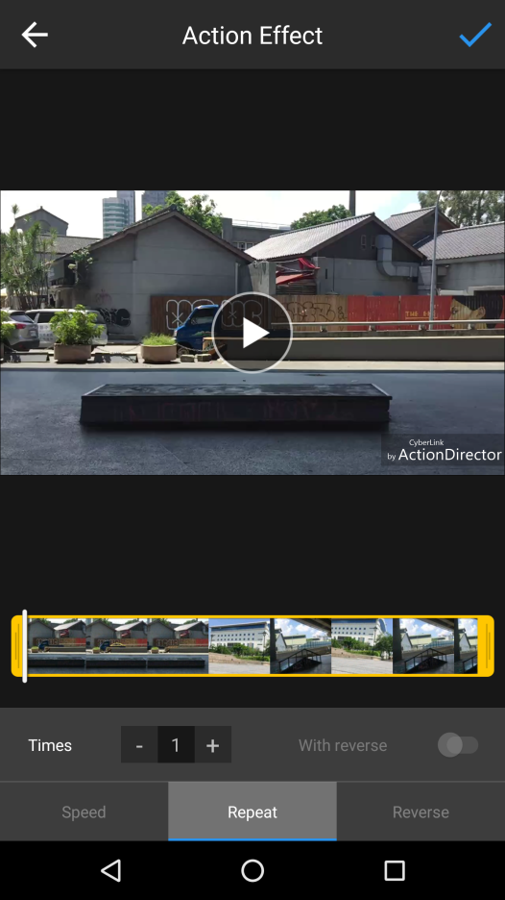
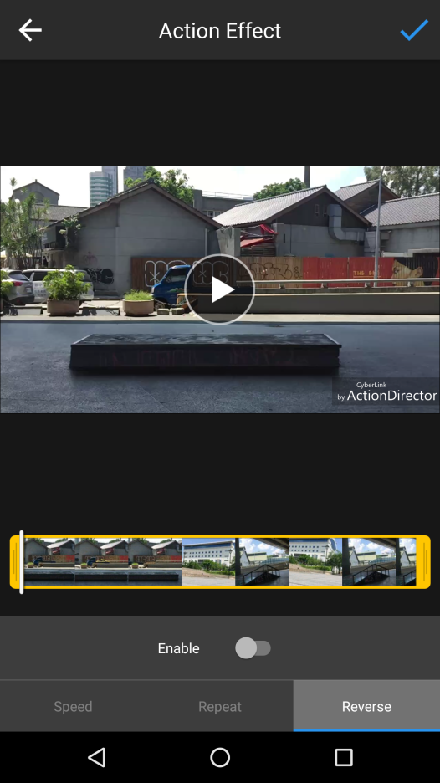
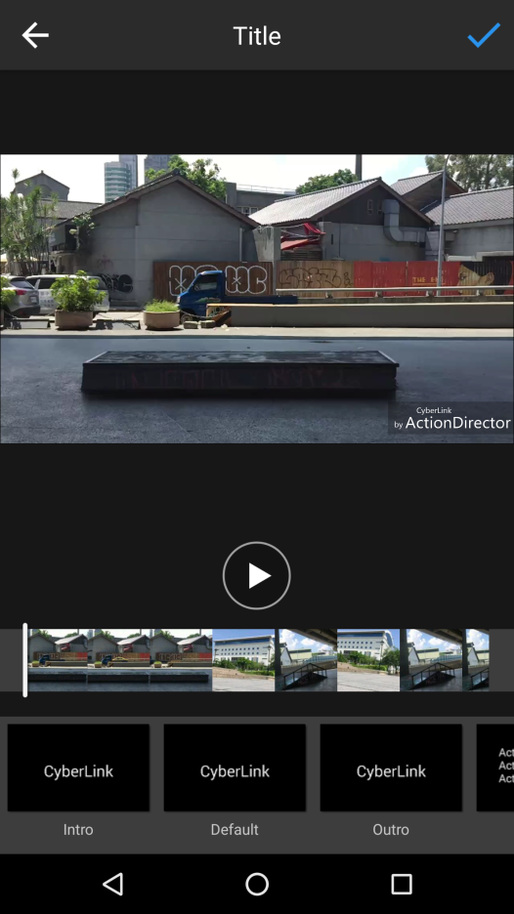
On Screen Helps
v
Show this tip next time
v
Show this tip next time
v
Show this tip next time
Video tutorial:
https://youtu.be/BahV2KXgXuA
Video tutorial:
https://youtu.be/VCX8znrrT4w
Video tutorial:
https://youtu.be/AcvC2iyA270
Set how many times you want the segment to repeat playback.
Drag the white bar or tap on timeline to seek in the video.
Enable if you want the video to play forward and backward as it loops playback.
Enable to make the video segment play in reverse.
Select the title template to add and to edit

Slide 5
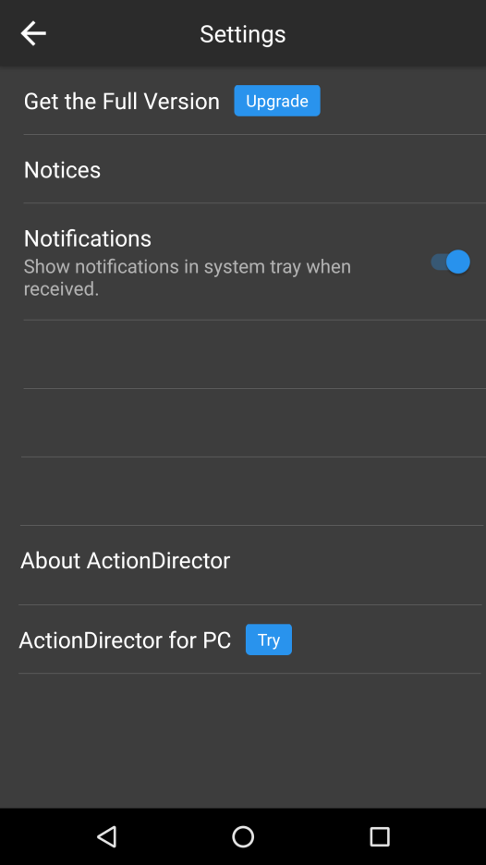
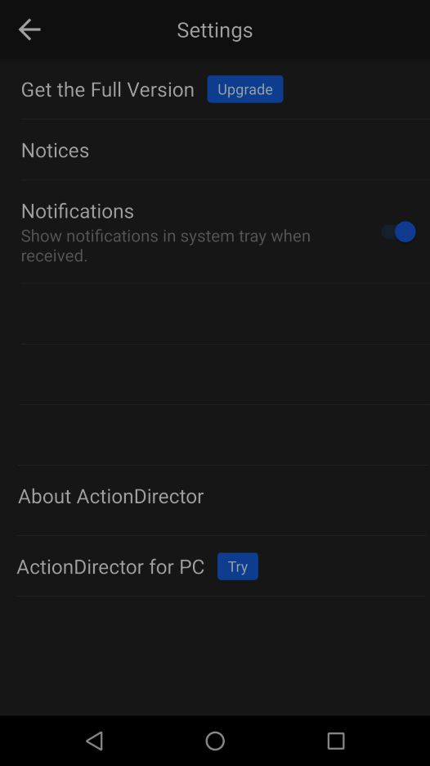
Settings: New Options
Reset all unchecked “Show this tip net time”
Reset All Tips
Would you like to give ActionDirector 5 stars? We’d really appreciate that.
Tap to pop up a dialog first
Rate This App
Send Feedback
Send Feedback
OK
Tap to Send Feedback page
Contact us via e-mail directly
Tap to Send Feedback
Tap to Google Play

Slide 6
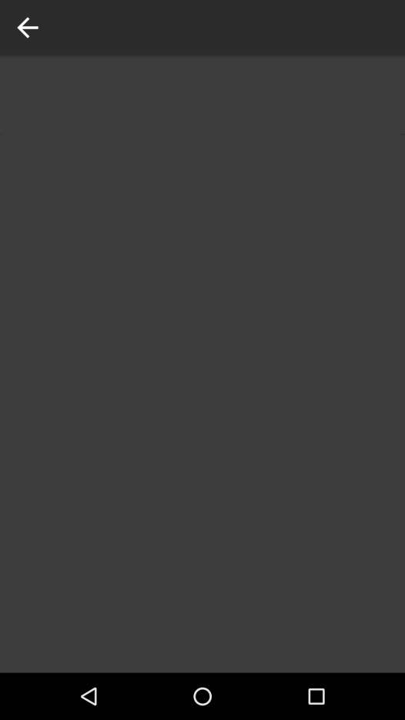


Settings: New Options
Send Feedback
Tap to send to ActionDirector_AppFeedback@cyberlink.com
Help us enhance this app with your new ideas by reporting any issue you might have experienced.
The same wording as PDR and PHD
E-mail
Add a screenshot
Tap to open photo library to attach

Slide 7
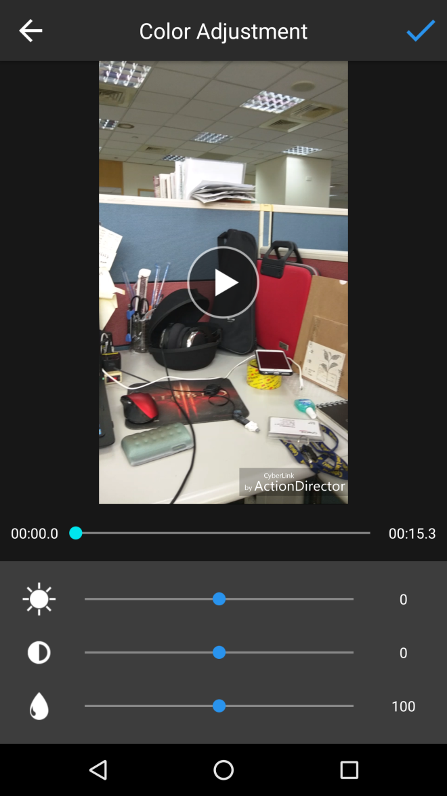
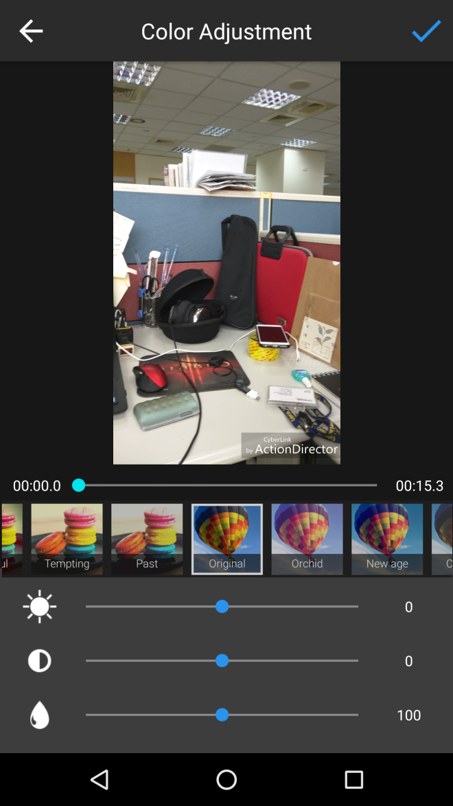
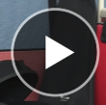
Color Presets
Current
Same preview size as in Title Designer

Slide 8
Color Presets
50 presets in 4 categories
Release the 1st batch in v1.1 for the first 6 presets in category 1,2,4 (don’t put Food presets)
The 2nd (green) in v1.11, then the 3rd (blue) in v1.2
Category #1 | Category #2 | Category #3 Food | Category #4
Film | Candy | Cake | Orchid
London | Aesthetic | Savory | New age
Spring | Gentle | Cuisine | Crescent
Autumn | Cool | Teatime | Gloom
Zephyr | Retro | Black Tea | Hippie
Process | Forest | Feast | Coffee
Tinted | Fresh | Divine | Nostalgia
Crystal | Elegant | Hazel | Modern
Verdant | Soft Light | Smoked | Matrix
Ancient | Vintage | Flavorful | Memory
Dawn | B&W | Temping | Noir
Dusk | Red | Past | Ochre
 | Warm
 | Light

Slide 9
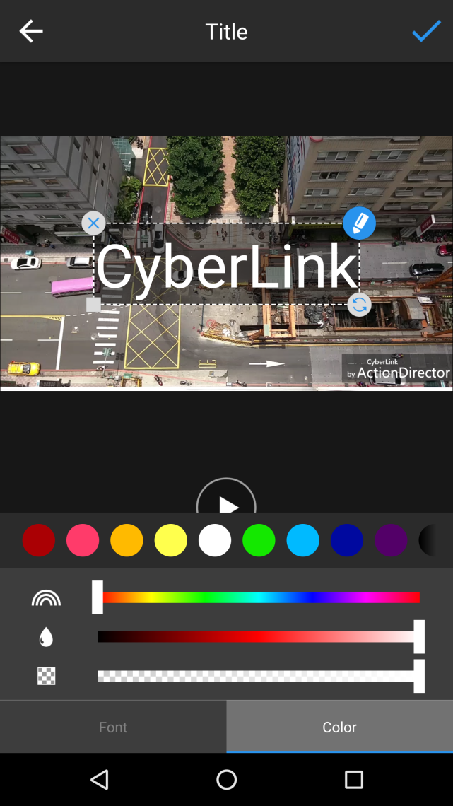
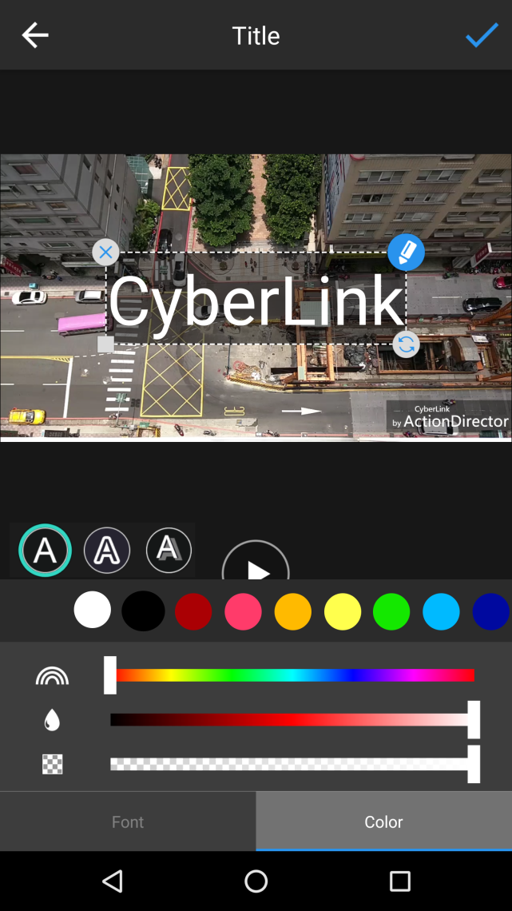
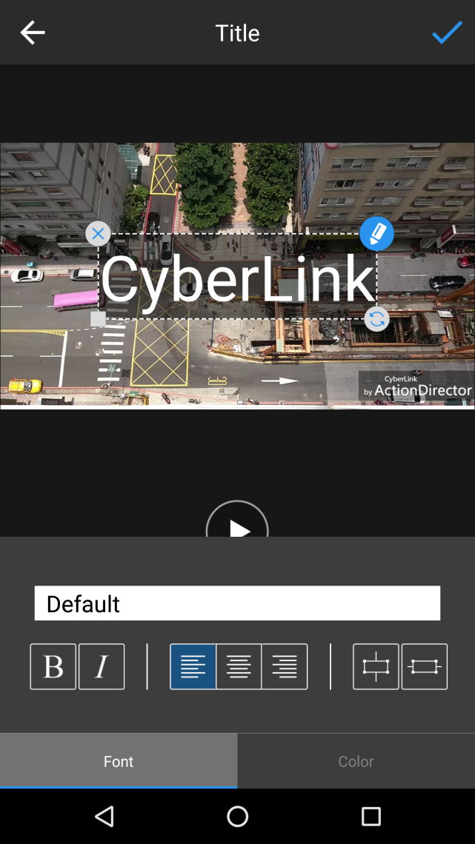
Title Designer: Shadow and Border controls
Current
Add 3 buttons to switch between font face, border and shadow.

Slide 10


Title Designer: Shadow and Border controls
If no border/shadow, display selection on the first color preset (transparent) and grey-out controls
Tap preset color to enable it

Slide 11
V2.0 Multiple clip supports
Related Features
Project
Project creation/delete
Auto save
Project list page
Editing
Storyboard
Support photo?
Able to add multiple clips
Pre-editing before adding to storyboard?
Cross-clip title

Slide 12
Workflow
Home page:
Import clip(s)/Capture
(Create project automatically)
Pre-editing:
Trim/Crop/Rotate video?
Add to/Remove from storyboard
Edit page:
Select a clip to edit
Produce/Share

